Slide 1
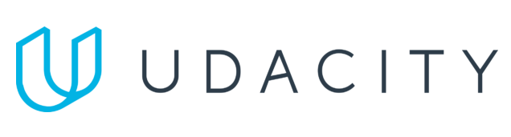
Data Lake Value Proposition
Medical Data Processing Company
Dotty Johnson
Udacity IPS Version 1.0

Slide 2
Agenda
What is a Data Lake
Components of a Data Lake
Data Lake vs Data Warehouse
Business Value of Data Lake Solution
Proposed Data Lake Architecture for Medical Data Processing system
Udacity IPS Ver. 1 2/2020

Slide 3
What is a Data Lake
Executive summary
Central place where we can bring together data, Machine Learning, and Analytics.
Can store data of any type, including unstructured, semi-structured, and structured.
Can handle scaling of any size.
Breaks data silos.
Schema on Read
Enables Analytics Use Cases

Slide 4
Components of Data Lake
Ingestion - tools to ingest data in Data Lake
Tools: Sqoop, Flume, Kafka
Processing - tools to process the data in Data Lake
Tools: Spark, HBase, Hive
Storage - Store the data at scale in a data lake. Mostly leveraging Object Storage solutions
Tools: HDFS
Orchestrations - Design and automate ETL workflows
Tools: Yarn

Slide 5
Data Lake vs Data Warehouse
< Think about: Research if a Data Warehouse can still be a viable solution instead of a Data Lake? What is the difference between both? >
< You will complete this information on the next slide. Please provide at least 3 items for each. No need to add any content on this slide >
< Video tip: While presenting the differences, elaborate why a Data Lake solution makes more sense for Medical Data Processing Company over a Data Warehouse approach? How the Data Lake / Big Data characteristics different from Data warehouse>

Slide 6
Data Warehouse
Data Lake
Stores data in structured format.
Traditional data warehouses employ Schema-on-Write. This requires an upfront data modeling exercise to define the schema for the data. Data is written in a specific schema format.
Storing data in Data warehouse is costlier and time-consuming.
Can store data of any type, including unstructured, semi-structured, and structured.
Uses Schema on Read technique. Data is written in original raw format. And enforce the schema when you need to read this data back.
Data storing in big data technologies are relatively inexpensive then storing data in a data warehouse..
Udacity IPS Ver. 1 2/2020

Slide 7
Business Value of Data Lake
Architecture should scale as data volume and velocity increases.
Centrally store all of the enterprise data and enable easy access.
Reliable and fault tolerant

Slide 8
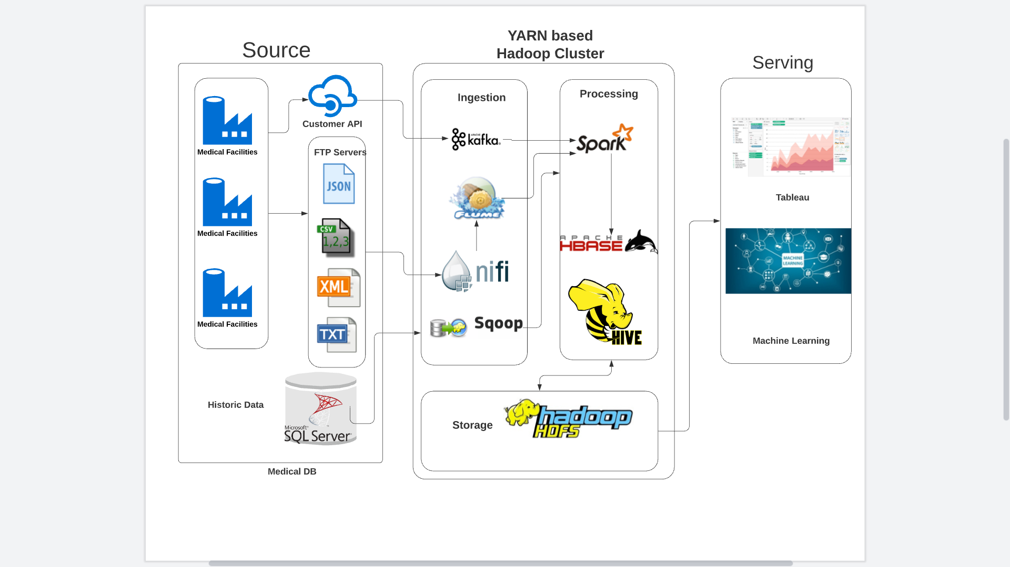
Data Lake Architecture

Slide 9
THANK YOU
Udacity IPS Version 1.0

